Slide 1


Supervised By
Ahmed Imtiaz
LECTURER
Dept. of Computer Science and Engineering
Rangamati Science and Technology University
PRESENTED TOPICS NAME
Simulation of IoT Based Smart Home Design Using MQTT Protocol
Submitted By
Muhammad Ainal Haque
Reg. NO : 2015-12-09
Session : 2015-16
Dept. of Computer Science and Engineering
Rangamati Science and Technology University
Presentation Date : March, 2022

Slide 2
1
Table Of Content
The project is divided into Some of View Point.
Introduction to the paper and the main objectives and motivations behind it.
Contains information about the Internet of Things (IoT) based Smart objects Management System.
Has information about the methodology that was adapted for this project and provides information about the design schemes. (Methodology)
Discuss results & discussion.
Discusses about Conclusion, Limitations and Future scope.

Slide 3
2
Motivation :
Permits users to design, build, configure smart home, smart city by providing different smart object used for them.
Offers a realistic simulation and visualization of IOT device
Provide board to control smart object
Objectives :
To create and construct an IoT-based Home Smart devices management system
Capable of regulating and automating most IoT Based functions via a user-friendly web interface.

Slide 4
3
Contains information about the Internet of Things (IoT) based Smart objects Management System.
What is IoT :
The Internet of Things (IoT) is a network of physical items, such as smart devices, vehicles and building, that are decorated with electronics, software, sensors, and network connectivity to collect and share data, resource.
The ever-growing network of physical objects with an IP address and the ability to connect to the internet, as well as the communication

Slide 5
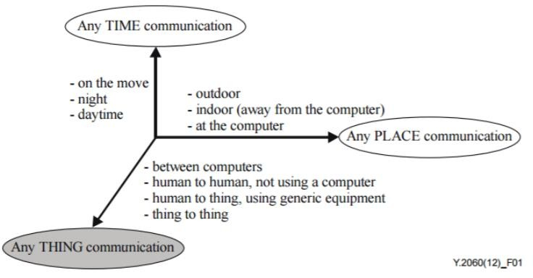
4
Figure 1. IoT compared to other modern technologies

Slide 6
5
(Methodology) : What is Home automation?
Mechanism of removing as much human interaction as technically possible and desirable in various domestic processes, and replacing them with programmed electronic systems—essentially the automation of the home and house work.

Slide 7
6
System Elements : HAWARE AND SOFTWARE REQUIREMENT
Sensors to measure or detect things like temperature, humidity, daylight or motion
Controllers such as a PC or a dedicated home automation controller.
For network connection ISP, Router, DNS Server and IoT Server.
Actuators such as motorized valves, light switches and motors. Buses for communication that can be wired or wireless.
Interfaces for human-machine and/or machine-to-machine interaction
To Simulation we have to also need the Cisco Packet Tracer 7.2.2 Software and MQTT Protocol.

Slide 8
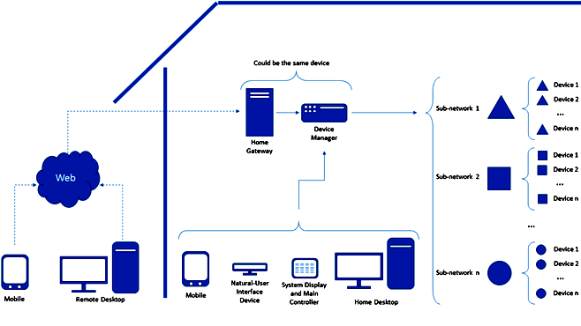
7
SMART HOME BLOCK DIAGRAM

Slide 9
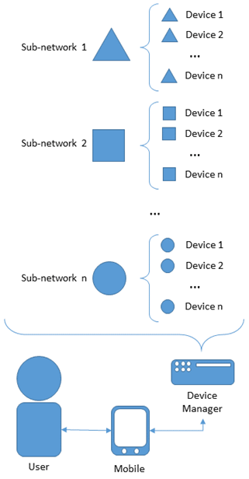
8
Control the Devices with their Subnnet

Slide 10
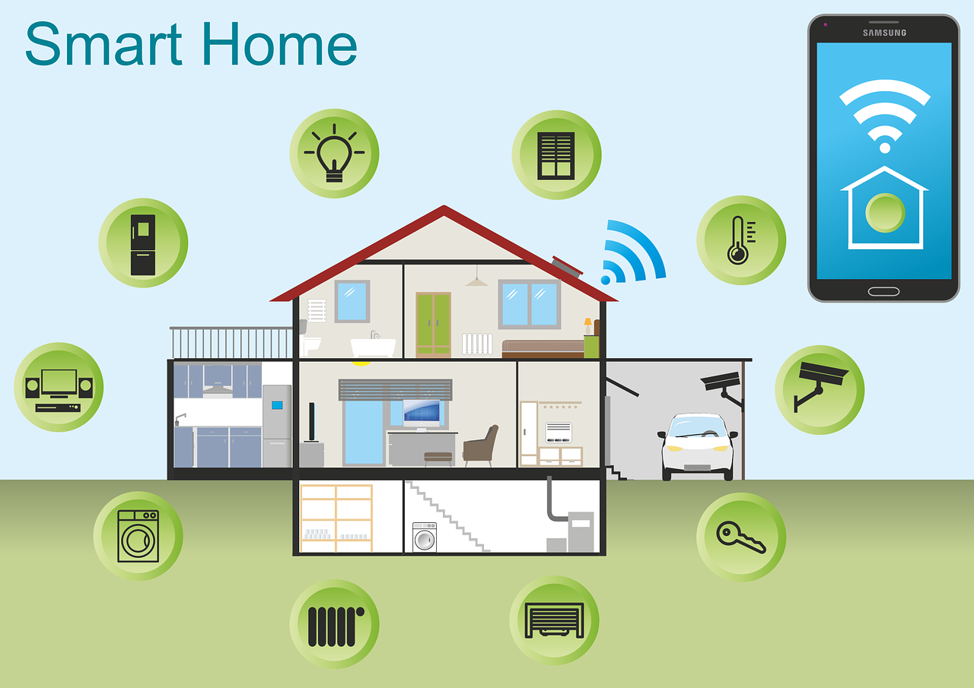
9

Slide 11
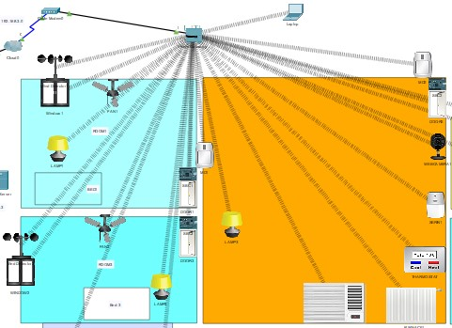
10
Home Automation

Slide 12
11
Benefits of Smart Home Automation :
Results in convenience
Energy efficiency
Safety benefits
Manage devices from a central point
Save time and money
Remote control of the home when you are out of home and town

Slide 13
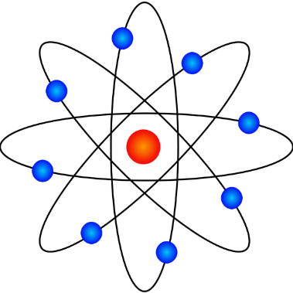
12
Regards
Any Query ?

